Slide 1
Sales Dataset Analysis - Advanced Excel Project
Name : Ganeshan S
Date : 17/03/2025
Course : Data Science and Data Analysis
Batch : Feb

Slide 2
Project Overview & Objectives
Project Objective:
Determine the best-selling products, analyze their sales patterns, and understand the factors contributing to their success.
Examine the relationships between top-selling products, sales channels, discounts, and other relevant factors to gain a deeper understanding of sales dynamics.
Identify the least selling products, analyze the reasons behind their poor performance, and develop
strategies to improve their sales.
Goals:
Provide actionable insights to enhance sales performance, identify areas of improvement, and capitalize on opportunities for growth.

Slide 3
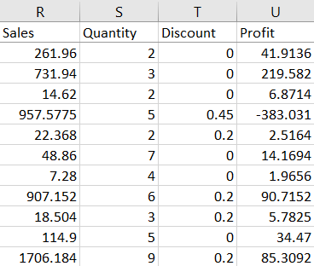
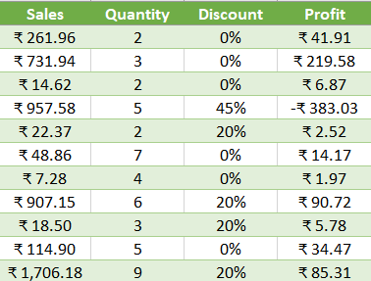
Data Description and Preparation
Dataset Overview:
In this Sales Data we have 9994 Rows with 21 columns.
Data Cleaning Process:
Used Power Query to convert column data types to the correct format,
Removed duplicate rows using Excel's "Remove Duplicates" feature,
Identified and addressed blank cells in the data.
Visuals:

Slide 4
Key Metrics Calculation and Data Analysis
Key Metrics:
Formulas:
Total sales =Sum(Sales)
Adjusted Sales =Sales – (Sales * Discount)
Average sales per order =Average(Sales)
Average Adj. sales per order =Average(Adjusted sales)
Discount % =Discount value / Total sales *100
Discount Values =Total sales – Adjusted sales
KPI | Values
Total Sales | ₹ 22,96,919.49
Adjusted sales | ₹ 19,74,421.77
Average sales per order | ₹ 229.85
Average Adjusted sales per order | ₹ 197.58
Discount% | 1404%
Discount Value | ₹ 3,22,497.72

Slide 5
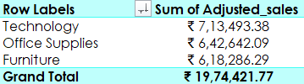
Pivot Tables and Pivot Charts
Pivot Table Summary:
I selected the entire data range, went to the "Insert" tab, and clicked on "PivotTable." I chose a cell to place the PivotTable and clicked "OK.“
Pivot Chart Visualizations:

Slide 6
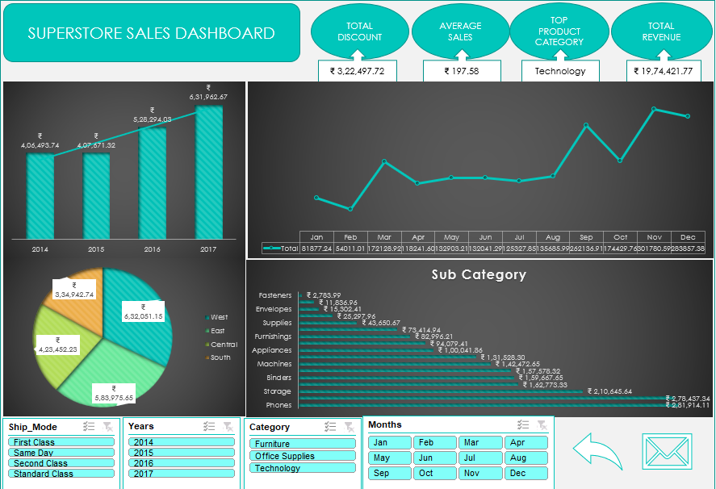
Dashboard Overview
Dashboard Design:
A dashboard is a visual representation of data that provides an at-a-glance view of key performance indicators (KPIs), trends, and insights. Its purpose is to make complex data more accessible, interactive, and actionable.
Visuals:

Slide 7
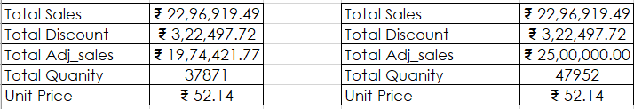
What-If Analysis & Goal Seek
What-If Analysis is the process of changing the values in cells to see how those changes will affect the outcome of formulas on the worksheet.
Goal Seek:
Create this go to Data > What-If-Analysis > Scenario Manager.
Below performs with some various sales increased and decreased discount and vice versa.

Slide 8
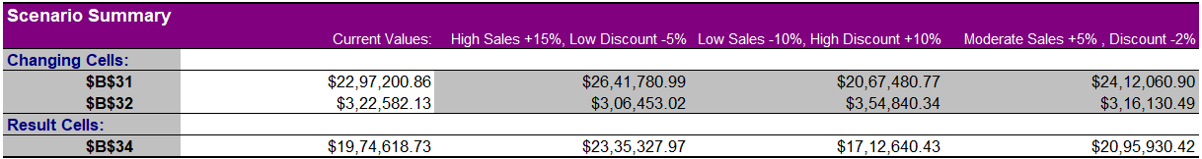
What-If Analysis – Scenario Manager
Create this go to Data > What-If-Analysis > Scenario Manager.
Below performs with some various sales increased and decreased discount and vice versa.

Slide 9
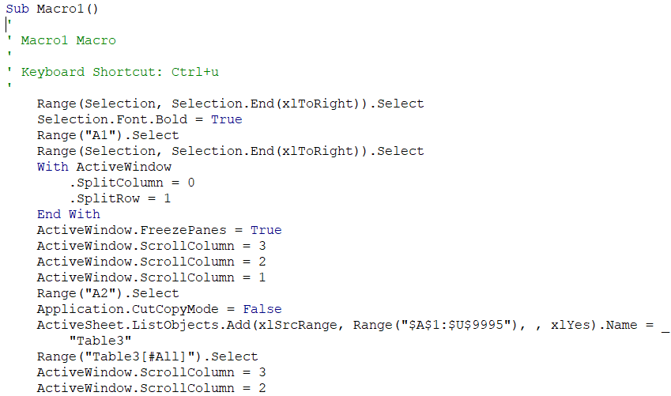

Macros and Automation
Macro Recording:
I used macros to automate the following tasks such as currency formatting, bolding headers, freezing panes.
Automation Benefits:
The use of macros significantly improved the efficiency and productivity of the analysis. By automating repetitive tasks, reducing manual effort, and minimizing errors, macros saved time and enabled me to focus on higher-level tasks and decision-making.
Visuals:

Slide 10
Insights and Recommendations
Key Insights:
The Technology category emerged as the best-performing sales category, accounting for 36% of total sales. Interestingly, the high sales volume in the Technology category coincided with a significant discount offering.
This suggests that the discount strategy was effective in driving sales.
Notably, seasonal sales variations were observed at the end of the year, with a surge in sales during this period.
This indicates that the holiday season (December to January) is a critical period for the Technology category, with customers taking advantage of discounts and promotions during this time. Based on the analysis, it is evident that the Fasteners product category has the lowest sales compared to all other sub-categories, despite having a relatively high discount rate of 17.80%. To boost sales in this category, we recommend increasing the discount rate on Fasteners-related products.
Other wise I have plans to close the Fasteners-related products.
This change can be monitored and adjusted as needed to ensure optimal results.

Slide 11
Conclusion
Summary:
From this Sales data Technology category offers the greatest opportunity for sales growth.
Discounts are an effective way to drive sales, particularly in the Technology category.
Seasonal sales planning is crucial to capitalize on peak sales periods.
Next Steps:
Increase investment in Technology category and allocate more resources to the Technology category to drive sales growth.
Develop seasonal sales plans: Create targeted sales plans to capitalize on peak sales periods, such as the holiday season.
By implementing these recommendations, the business can drive sales growth, increase revenue, and maintain a competitive edge in the market.

Slide 12
Questions
Thank you for your attention!
Welcome your questions and comments!
Please feel free to ask questions or share your insights!

Slide 13
THANK YOU

